Slide 1

BLACKTECH SALES EXECUTIVE SUMMARY
PREPARED BY
Chibuzo E. Oha

Slide 2
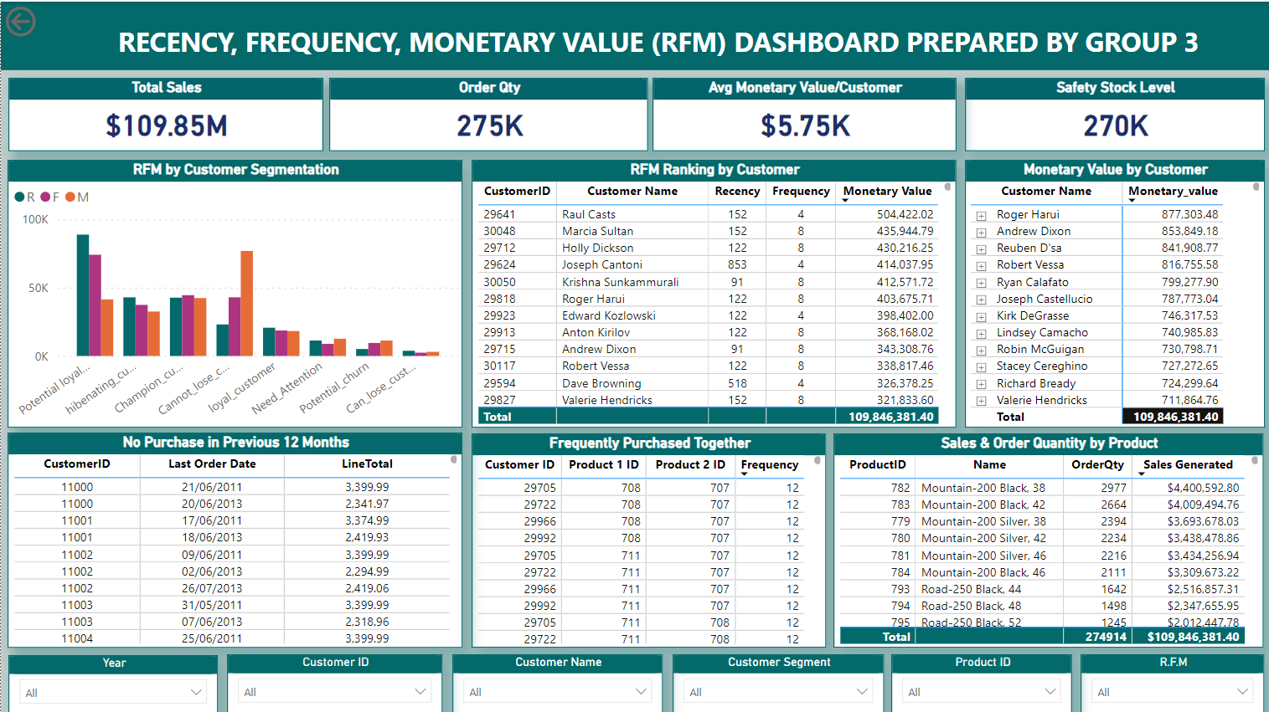
BLACKTECH SALES EXECUTIVE DASHBOARD

Slide 3
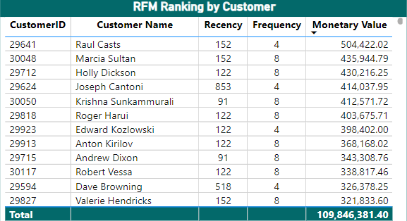
INSIGHTS FROM BLACKTECH SALES DATA
Customers based on their Recency, Frequency, and Monetary value
Customer Segmentation
Potential loyalist customers.
Potential churn customers.
Champion customers.
Cannot lose customers.
Hibernating customers.
Loyal customers.
Need attention customers.
Can lose customers.

Slide 4
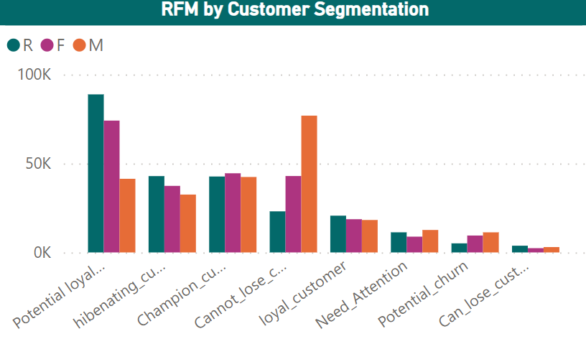
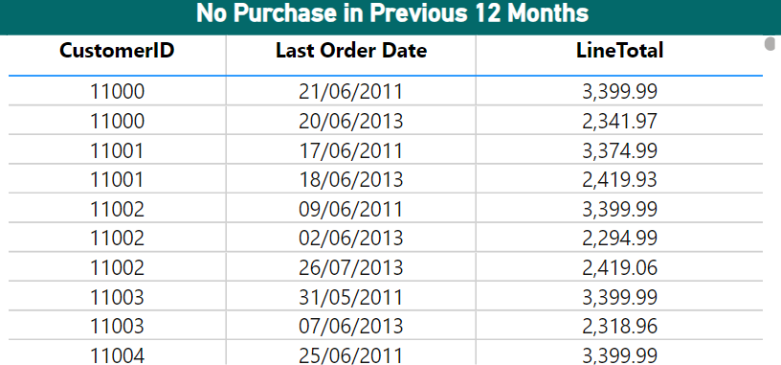
INSIGHTS FROM BLACKTECH SALES DATA
Customers at risk of churning
Customers who have not made purchase in last 12 months

Slide 5
RECOMMENDATIONS
How can we reach out to churning customers with personalized offers or interventions
Send personalize email
Phone calls
Questionnaires
Organizing public event
What are the proactive measures to retain them?
Rebate
Discount
Gift Voucher
How can we identify opportunities for cross-selling or upselling to our existing customer base?
Cross Selling
Ensure the two cross selling products are available always.
Introduce discounts and promo on products that are not selling well but are complimentary products.
Train marketers and customer service personnel on how to convince customers to buy complimentary or upgraded products
Upselling
Introduce high end products to the market to give people choices to pick from.
Train our marketers and customer service agents on how to educate people on upgraded products.

Slide 6
RECOMMENDATIONS
How can we optimize our marketing campaigns to target the right customers at the right time?
Determine the customers re-purchase time through historical data, RFM and sales data and send out emails and start marketing
Market product that are seasonal and festival dependent two months ahead of time
From our data marketing and Campaign should start from February.
How can we manage our inventory efficiently based on customer demand and preferences and ensure sufficient stock availability for those products?
Understand your customer’s behavior from the sales data.
Use of historical data to determine safety stock level
Use of inventory control software

Slide 7

Thank you

